Slide 1
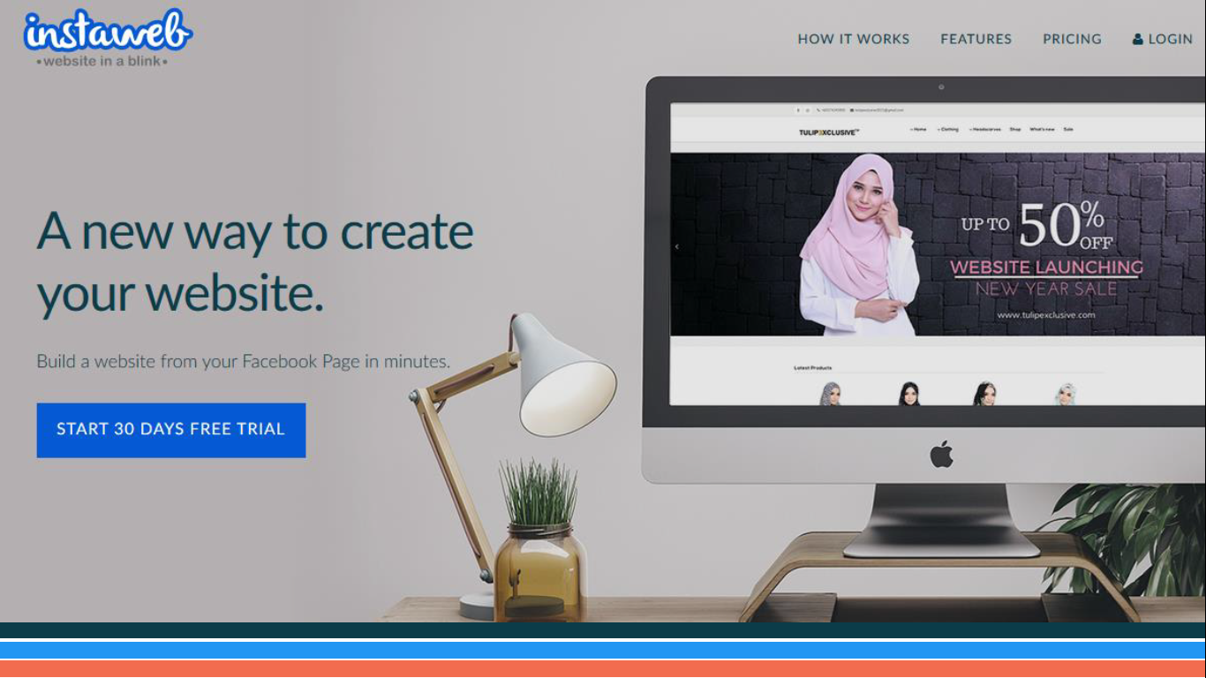

Slide 2
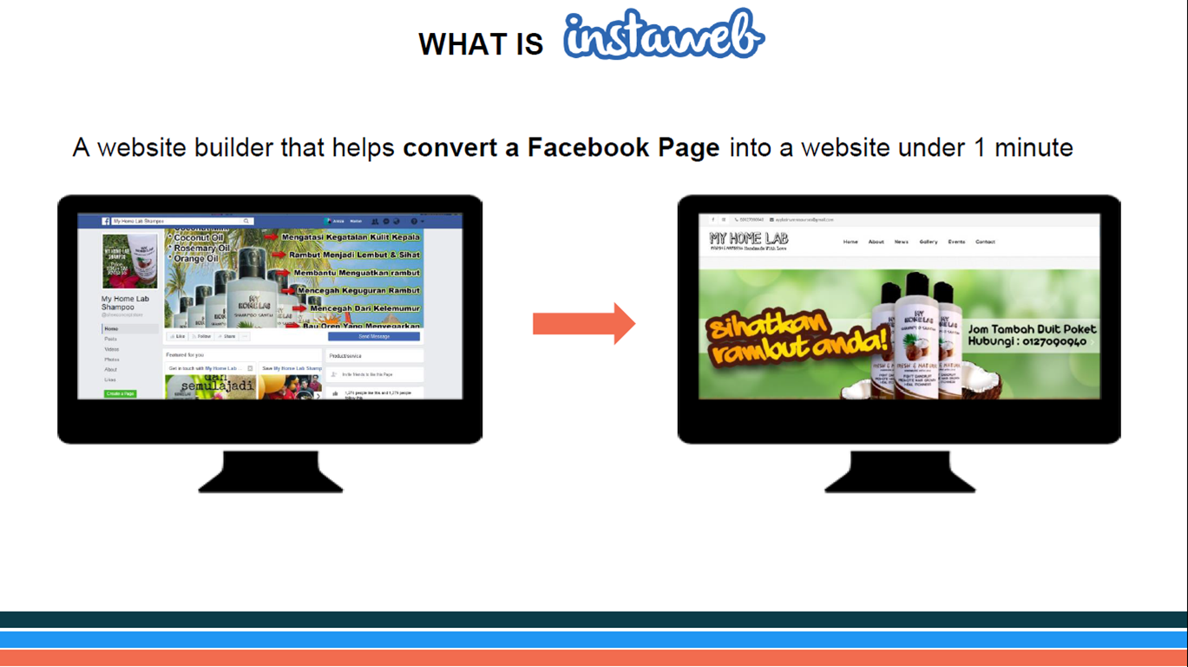

Slide 3
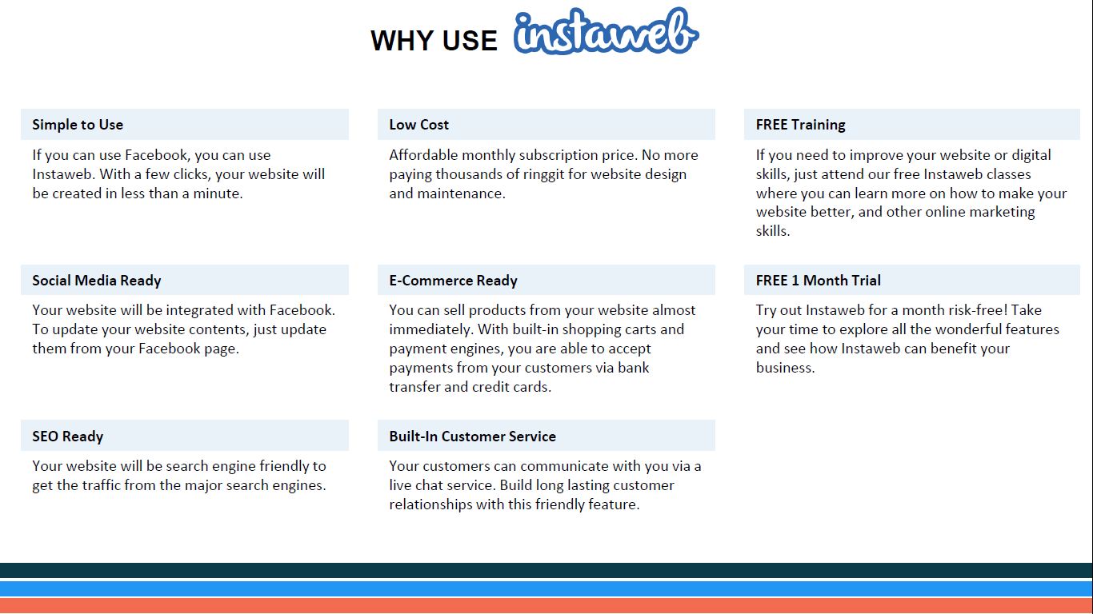

Slide 4
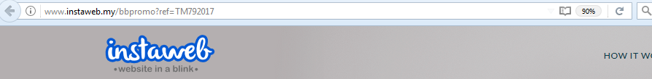
The Unique URL : TM or BB Promo
The URL will be appear at new tab Normal Price – RM 49.90
The URL will be appear at new tab for TM Promo – RM 10.00
https://www.instaweb.my/godigital?ref=TM3502017
https://www.instaweb.my/godigital?ref=TM3492017
Special URL to enjoy the promo price.

Slide 5
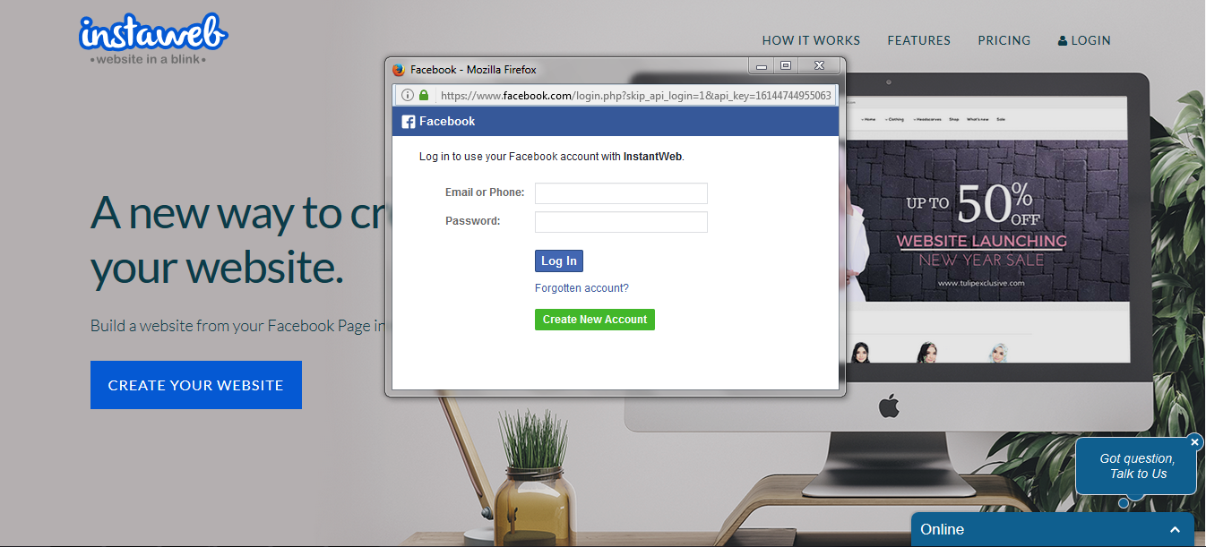
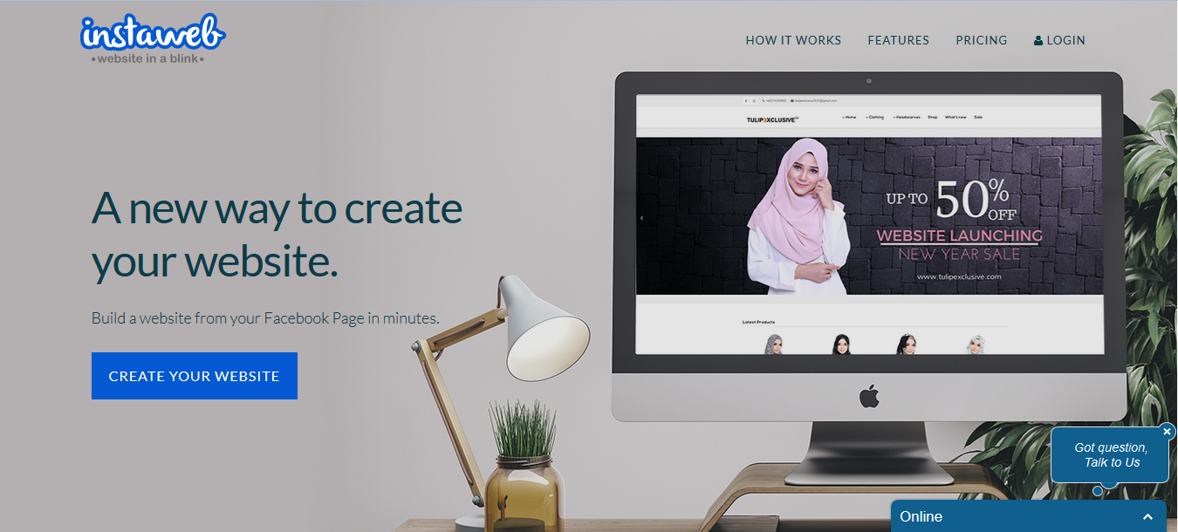


Step by Step to Register Instaweb
3
Log in using Customer FB account

Slide 6
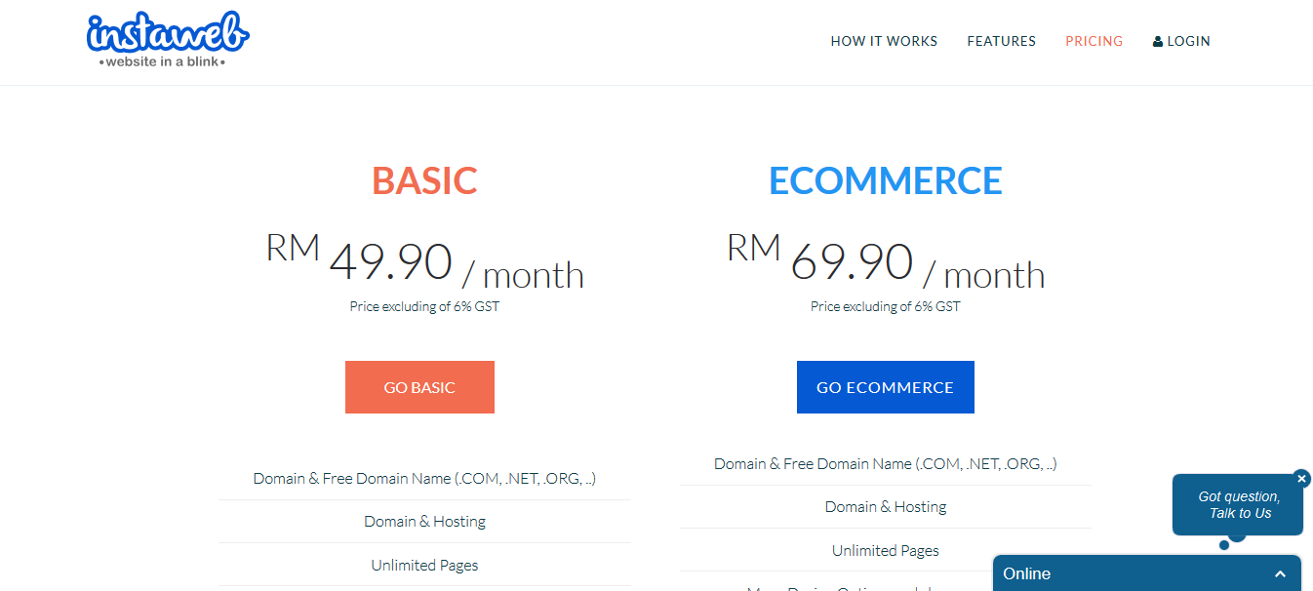
Step by Step to Register Instaweb
4
Select ‘Package’

Slide 7
Step by Step to Register Instaweb
5
Log in Customer FB account

Slide 8
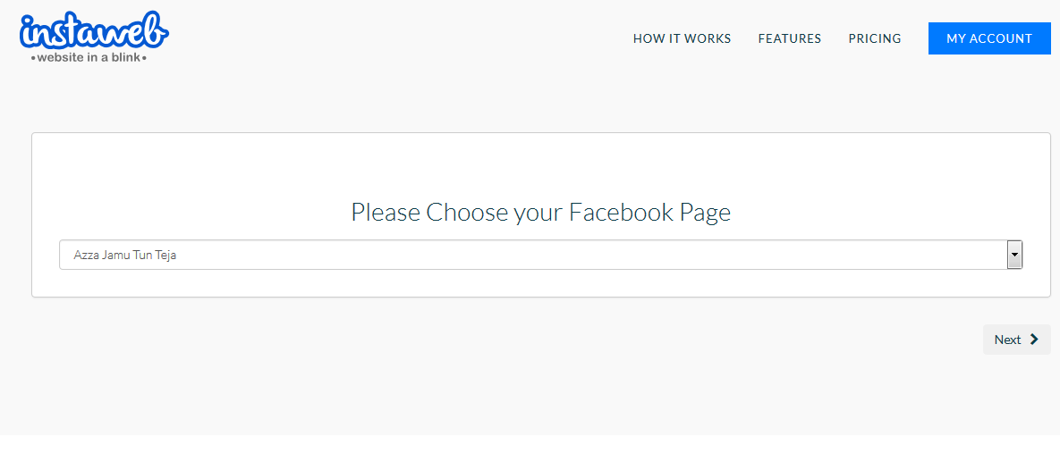
Step by Step to Register Instaweb
6
Choose Facebook page

Slide 9
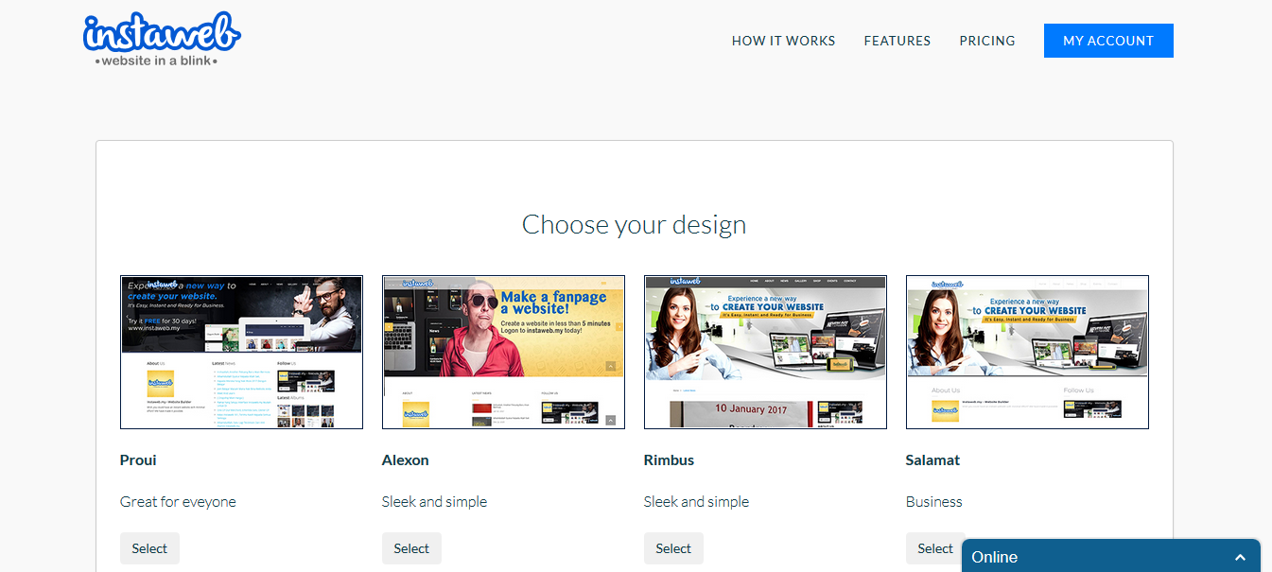
Step by Step to Register Instaweb
7
Choose your design

Slide 10
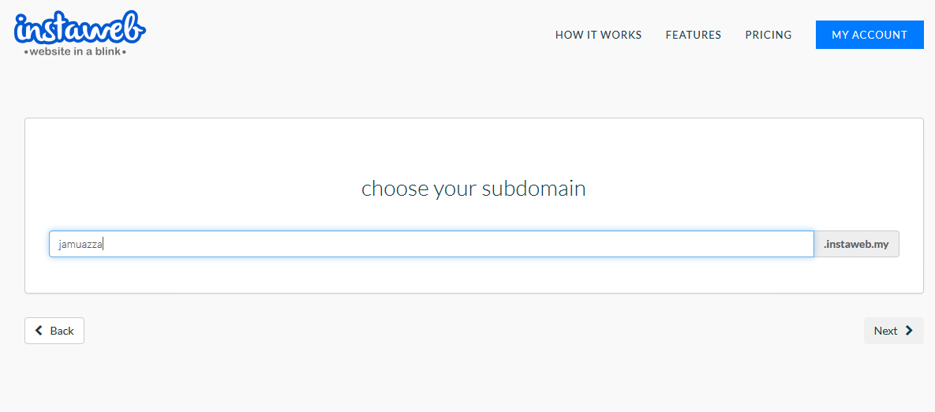
Step by Step to Register Instaweb
8
Choose your temporary subdomain

Slide 11
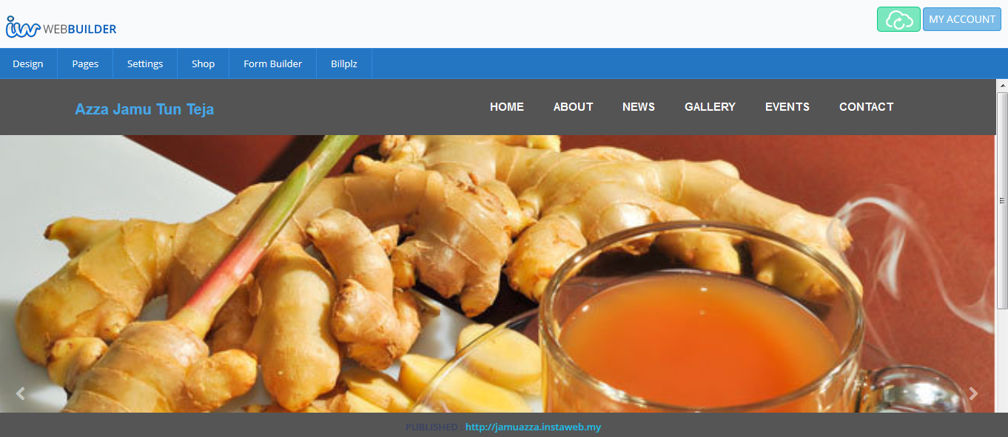
Step by Step to Register Instaweb
9
Your Website is READY!!!

Slide 12
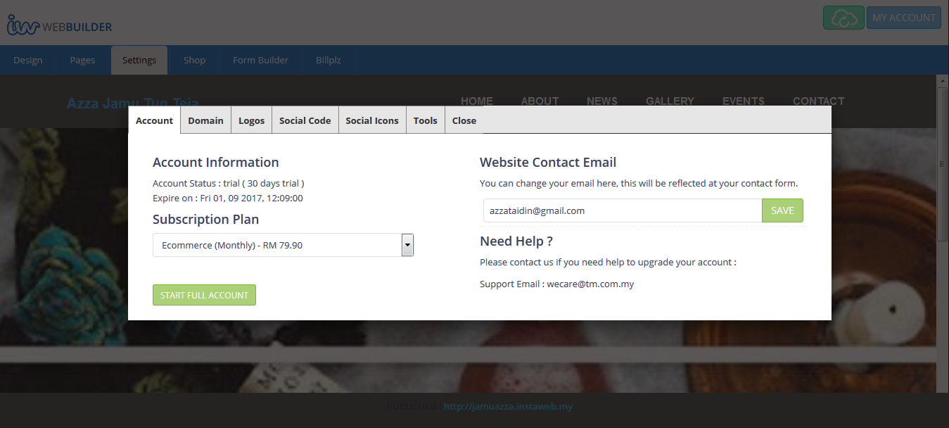
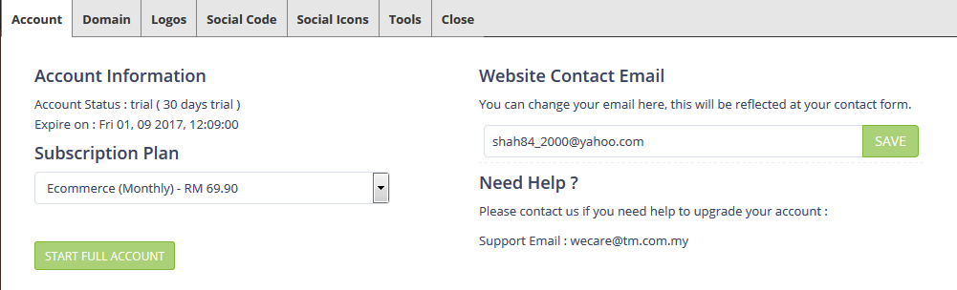

Step by Step to Register Instaweb
10
Click Setting ang Go ‘Start Full Account’

Slide 13
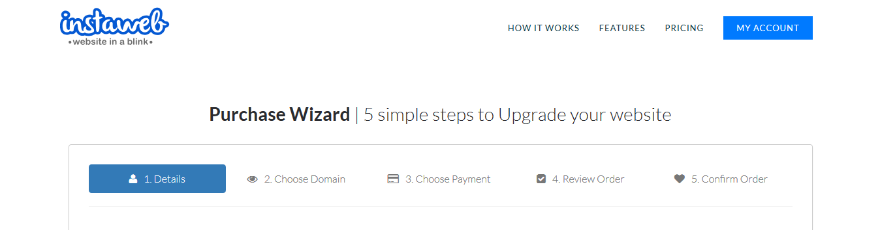
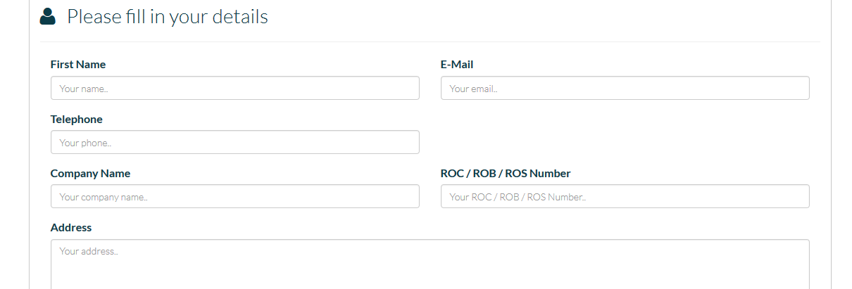
Step by Step to Register Instaweb
11
Fill in the Details

Slide 14
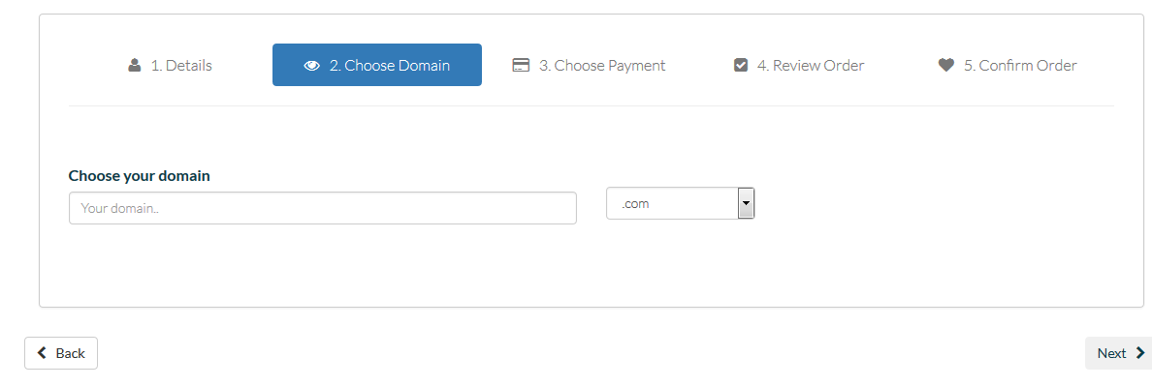

Step by Step to Register Instaweb
12
Choose Preferred Domain

Slide 15
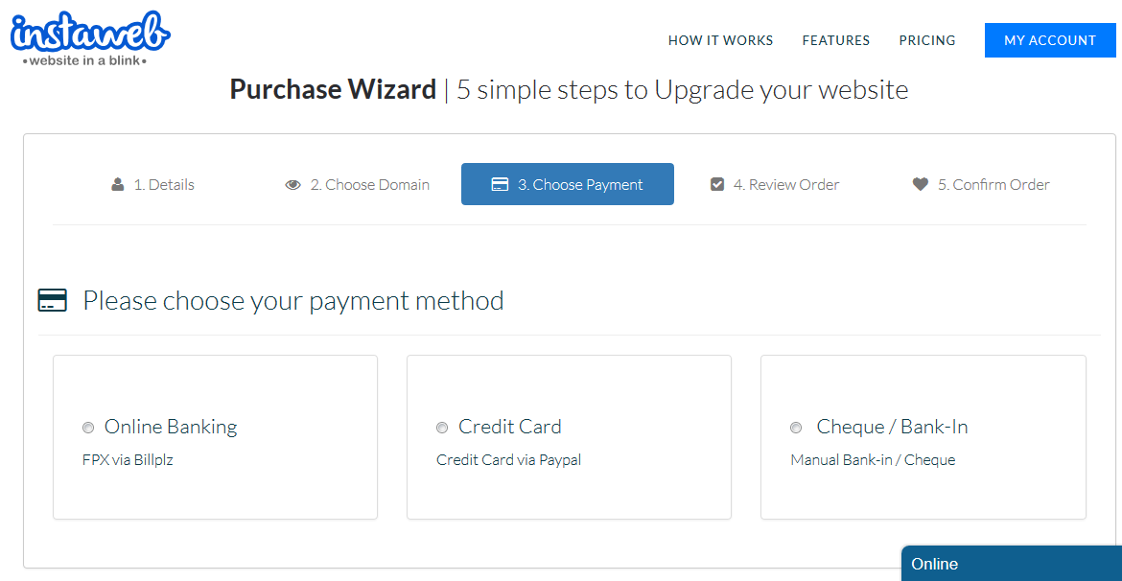
Step by Step to Register Instaweb
13
Choose Payment Method

Slide 16
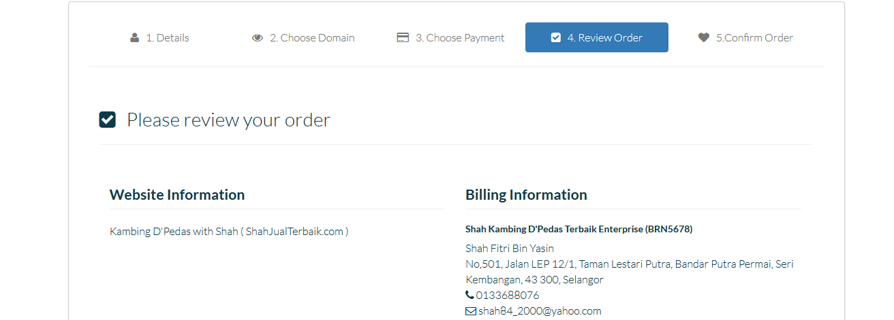
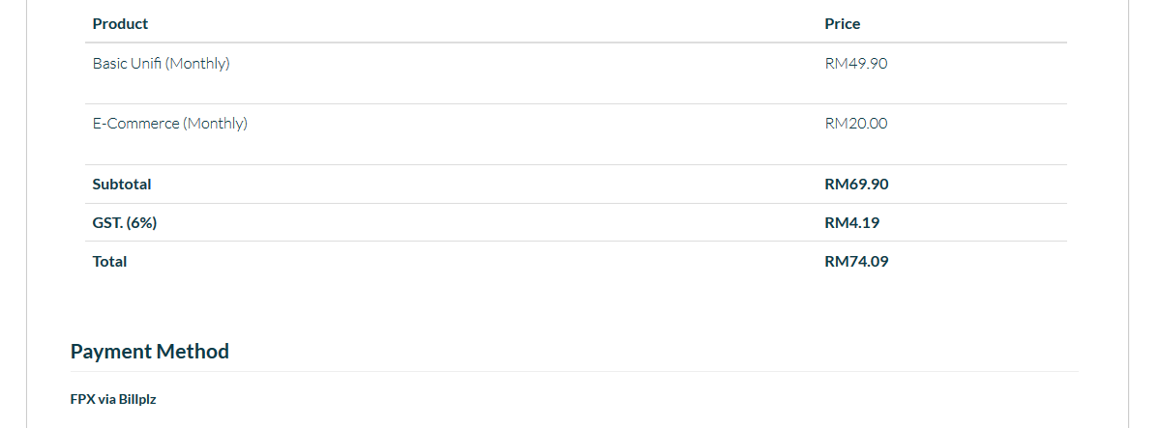
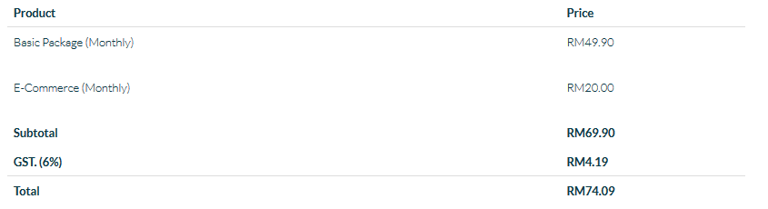


Step by Step to Register Instaweb
14
Review Order

Slide 17
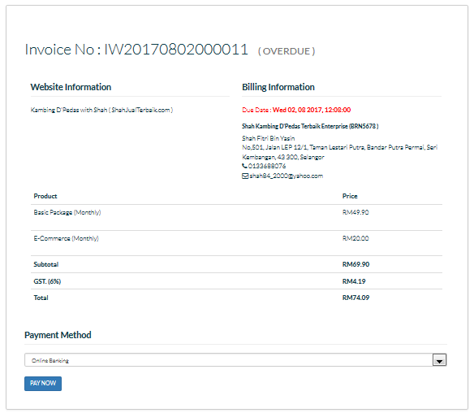
Step by Step to Register Instaweb
15
Receipt of Purchase is READY! Please make payment…

Slide 18
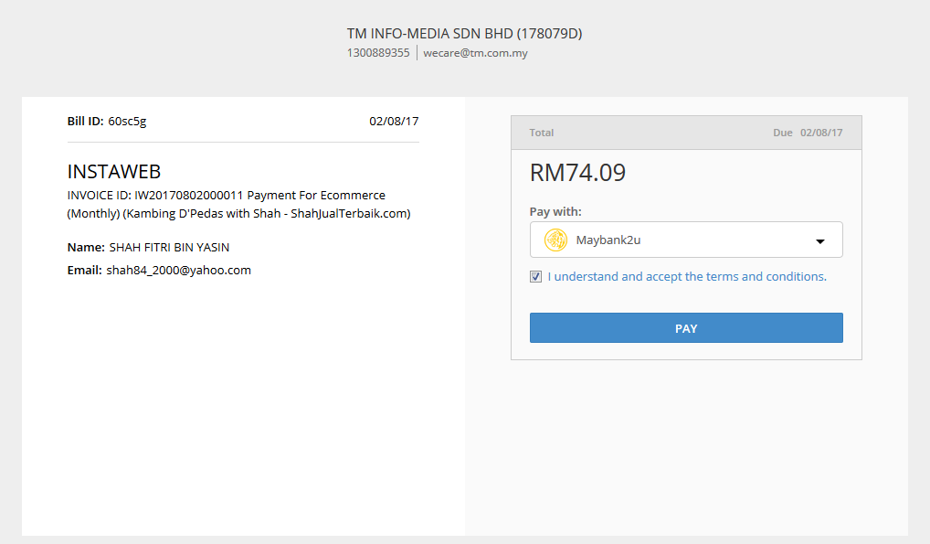
Step by Step to Register Instaweb
16
If Make ONLINE payment

Slide 19
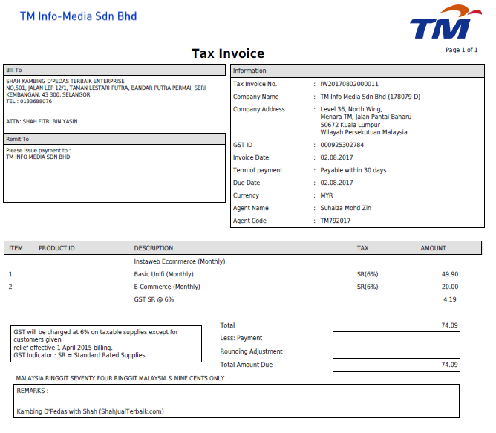
Sample Bill
17

