Slide 1
Gorgeous Geeks
Women Netpreneur Programme 2018-2019

Slide 2
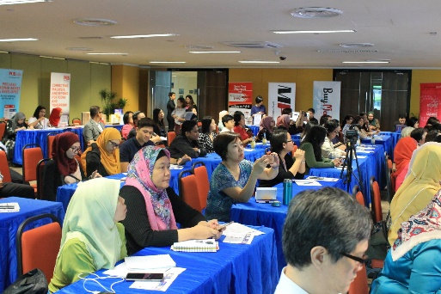
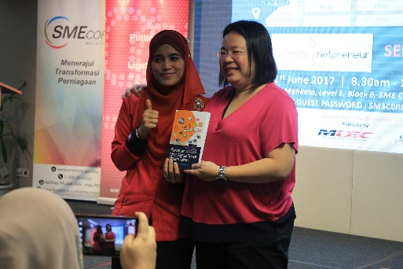
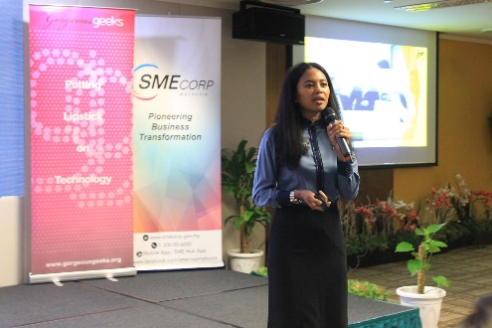
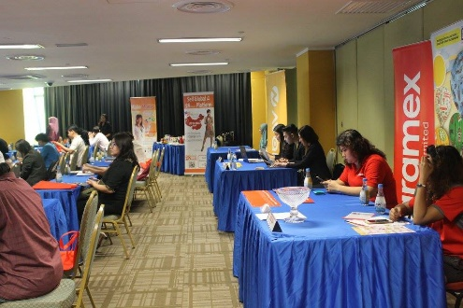
GG Netpreneur Series
To date the Women Netprenuer Series has trained over 1,000 since the program started in 2012 in Kuala Lumpur. With the success of the Women Netprenuer 2017: eCommerce Adoption program, Gorgeous Geeks continue to collaborate with Malaysia SME Corp to extend the programme to the rest of the states in Malaysia in 2018-2019.
We hope that through Women Netprenuer this will enable more women entrepreneur throughout the country to expand their business beyond the physical boundaries through eCommerce Adoption and redesign their business model for the digital era.
This year Women Netpreneur: eCommerce Adoption will run across 8 locations in Malaysia. In addition, there will be 2 digital business workshops in East and West Malaysia for business to relook into their digital business model and customer journey.

Slide 3
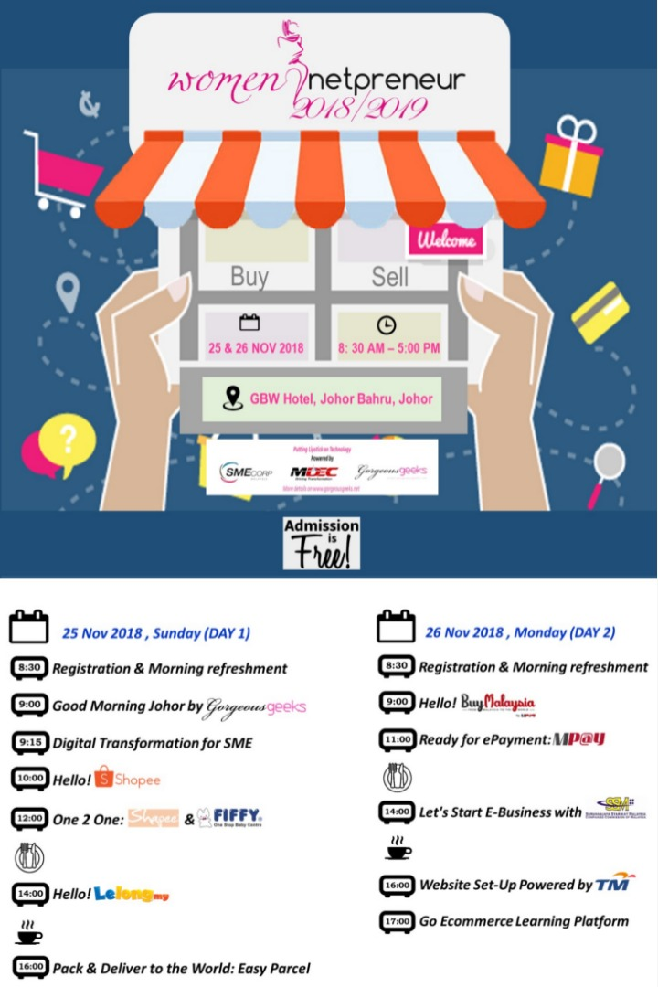
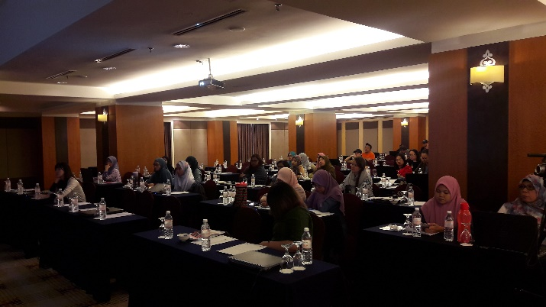
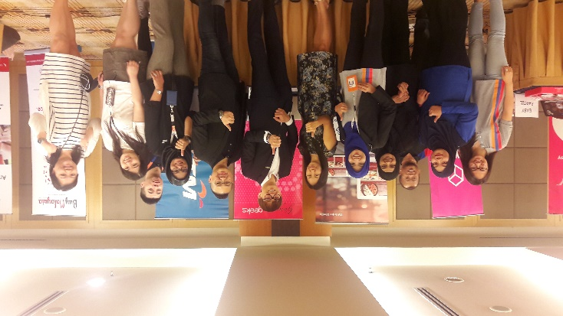
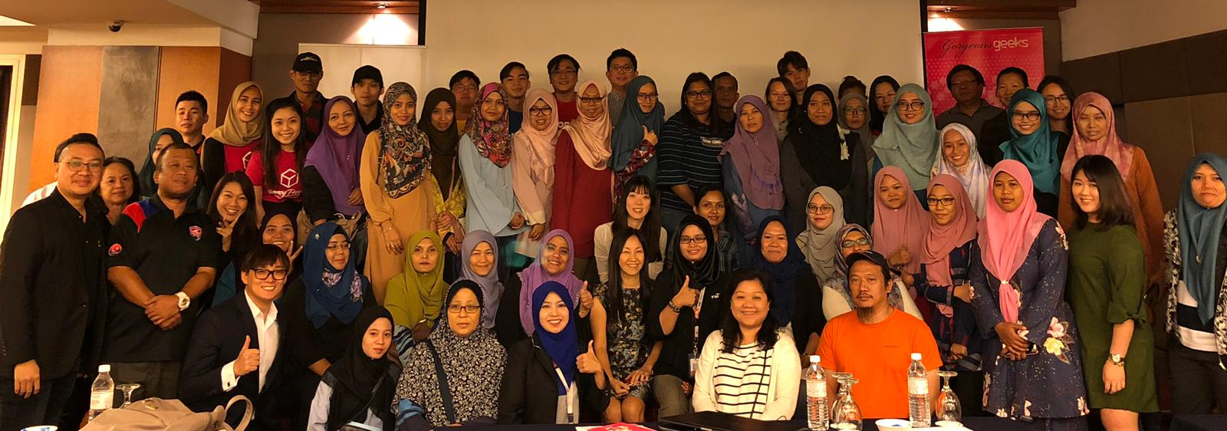
Agenda – Johor Bahru

Slide 4
Women Netpreneuer 2018-2019
8 eCommerce Adoption stations
Johor 25-26 Nov 18
Penang 12 – 13 Mar 19
2 Digital Business Workshops
Kuching / K. Kinabalu 19-20 Nov 19
KL 26-27 Nov 19
K. Terengganu 23-24 Apr 19
Kuching 15-16 July 19
Miri 18-19 July 19
Cover Digital Business Model and Customer Journey to target on seller that have existing brick and mortal business with physical store
K. Kinabalu 23-24 Sep 19
Tawau 26-27 Sep 19
K. Lumpur 23-24 Oct 19

Slide 5
THANK YOU

Slide 6
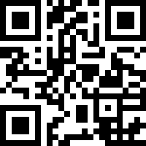
We would like to hear your feedback
http://bit.ly/2VHMu5A

Slide 7


Slide 8
